Slide 1
HOT WORKING & COLD WORKING PROCESS

Slide 2
METAL FORMING PROCESS
COLD WORKING
COLD ROLLING
COLD EXTRUSION
COLD FORGING
WIRE DRAWING
SHEET METAL PROCESS
HOT WORKING
FORGING
ROLLING
EXTRUSION
HOT DRAWING

Slide 3
RE- CRYSTALLISATION TEMPERATURE
METAL TEMP. (degree Cel.)
ALUMINIUM 150
COPPER 200
IRON 450
NICKEL 590
ZINC At room temp
LEAD Below room temp
TIN Below room temp

Slide 4
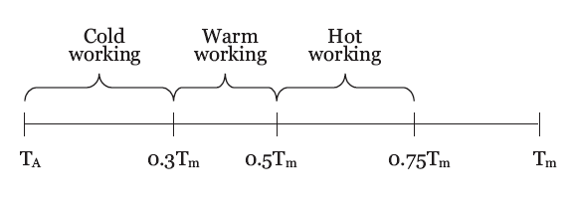

HOT AND COLD WORKING

Slide 5
Advantages of HOT WORKING
Large deformation can be obtained
In hot working process, the grain structure of the metal is refined and thus mechanical properties improved
Porosity of the metal is considerably minimized
If process is properly carried out, hot work does not affect tensile strength, hardness, corrosion resistance, etc
No residual stresses are introduced in the metal due to hot working.
Concentrated impurities, if any in the metal are disintegrated and distributed throughout the metal

Slide 6
Disadvantages of HOT WORKING
Some metals cannot be hot worked because of their brittleness at high temperatures.
Handling and maintaining of hot working setups is difficult and troublesome.
Because of the thermal expansion of metals, the dimensional accuracy in hot working is difficult to achieve.
Rapid oxidation of metals occures
Friction and tool wear are more severe in hot working

Slide 7
PRINCIPAL OF HOT WORKING
HOT WORKING
FORGING
ROLLING
EXTRUSION
HOT DRAWING

Slide 8
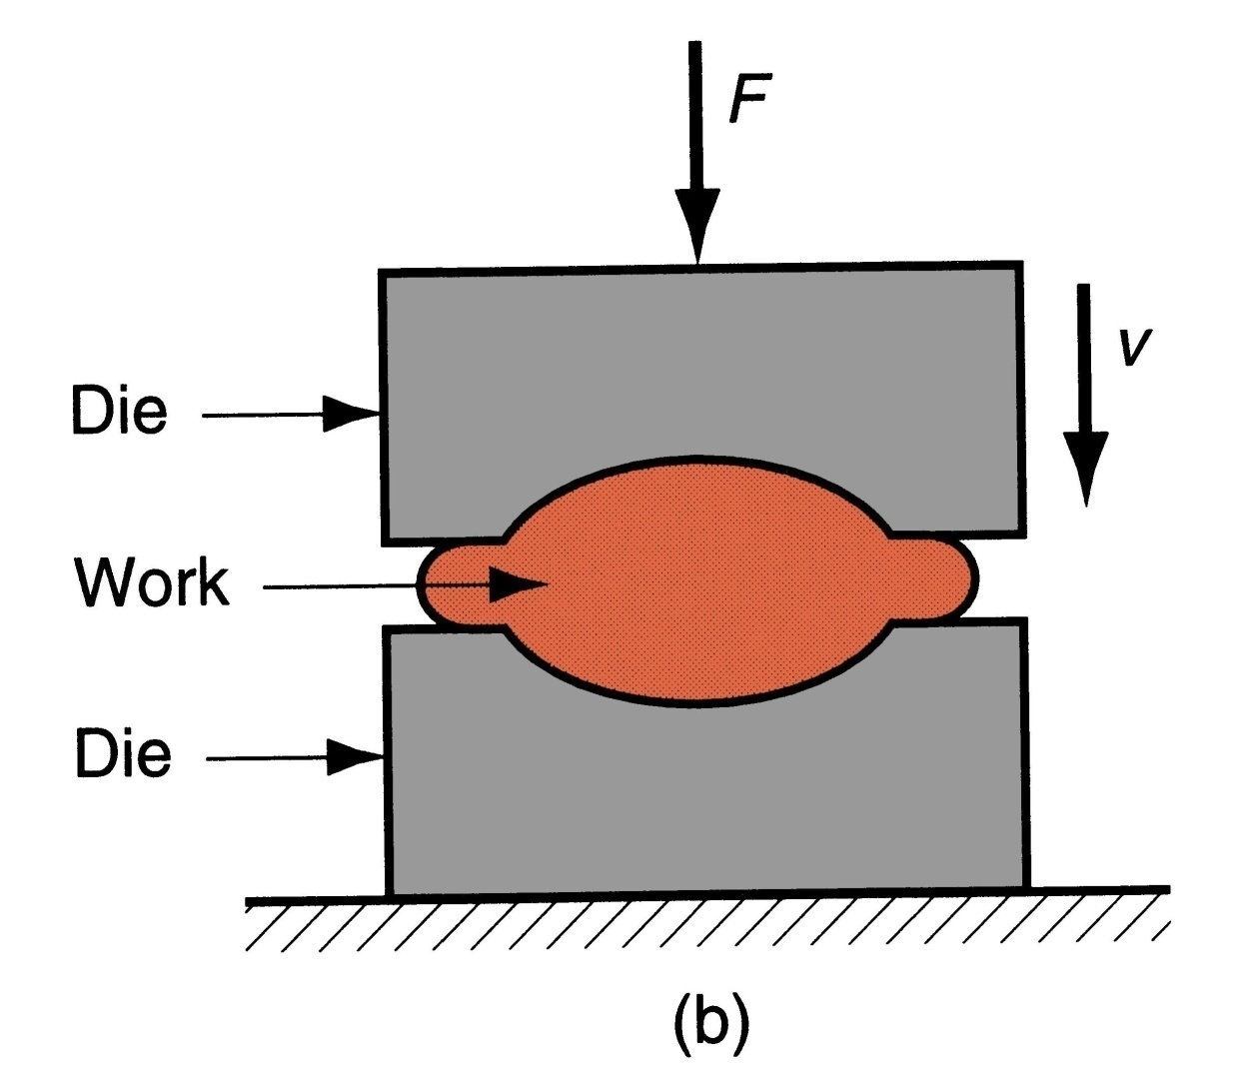
FORGING
Basic bulk deformation processes: forging

Slide 9
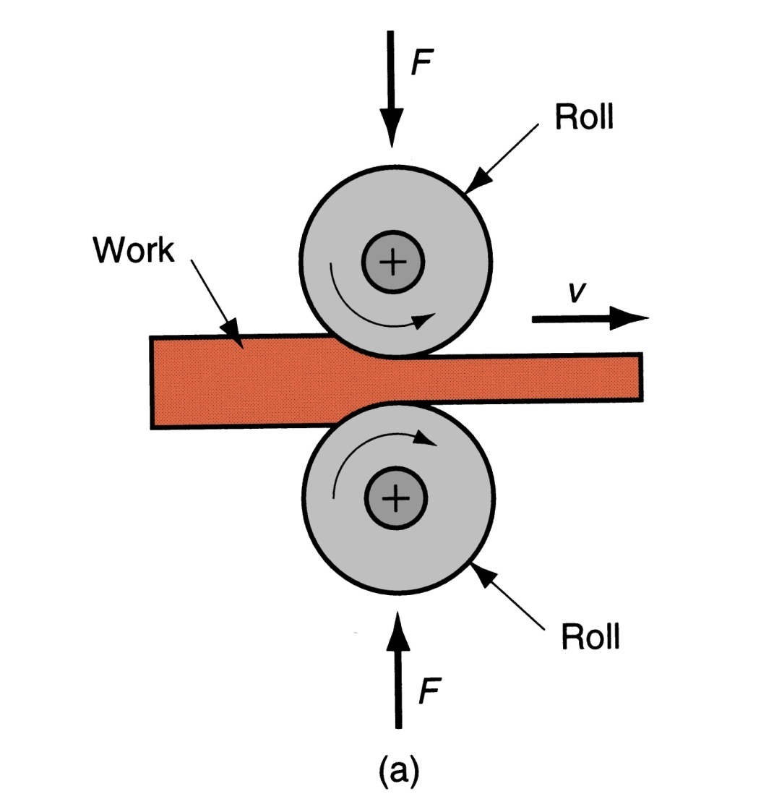
ROLLING
Basic bulk deformation processes: (a) rolling

Slide 10
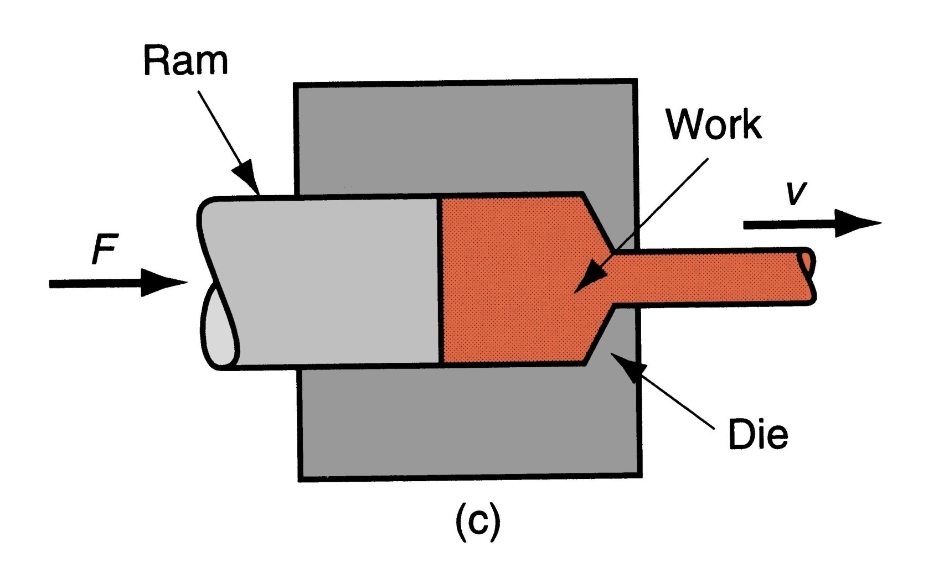
EXTRUSION
Basic bulk deformation processes: (c) extrusion

Slide 11
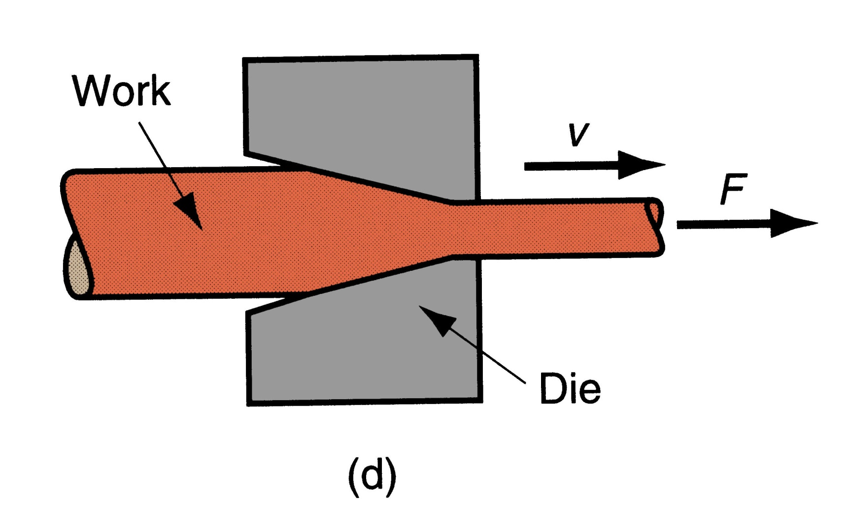
HOT DRAWING
Basic bulk deformation processes: Hot drawing

Slide 12
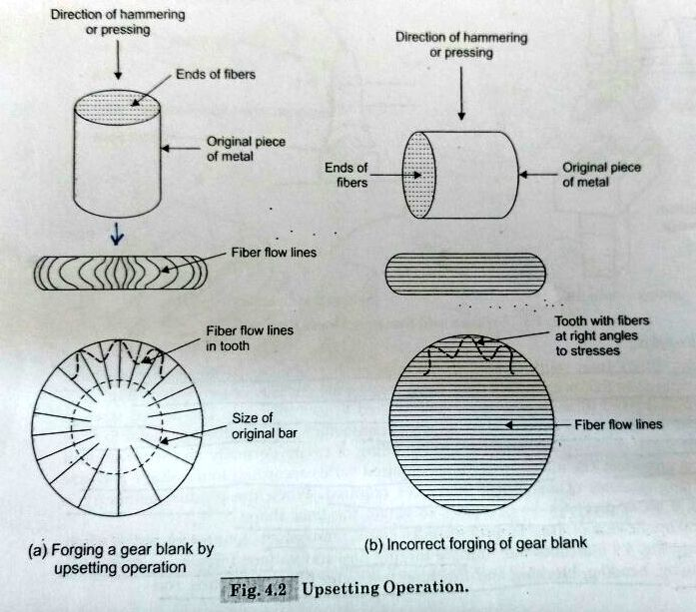
GRAIN FLOW

Slide 13
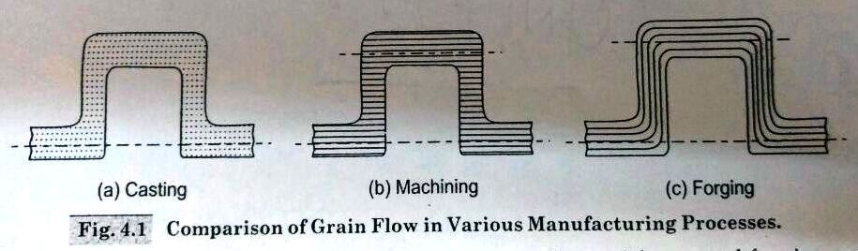
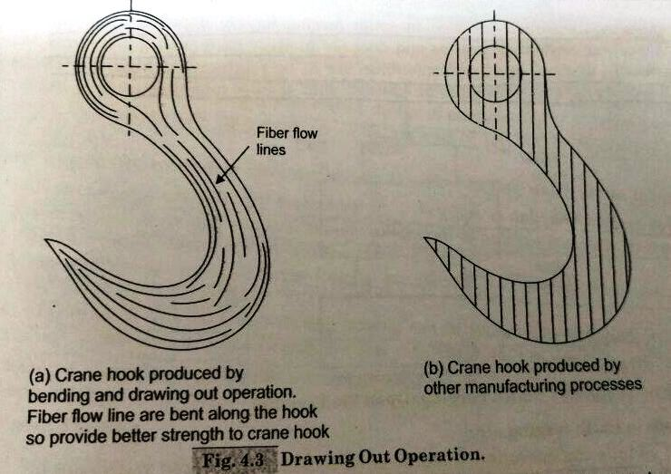
GRAIN FLOW

Slide 14
FORGING METHODS
SMITH FORGING
DROP FORGING
PRESS FORGING
MACHINE OR UPSET FORGING

Slide 15
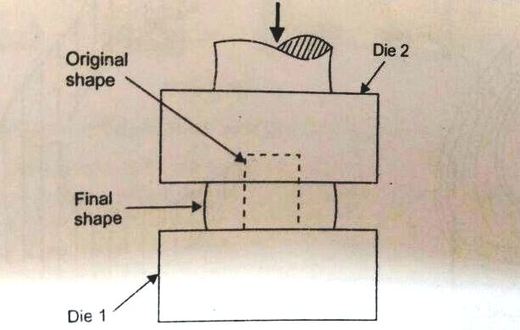
SMITH OR HAND FORGING

Slide 16
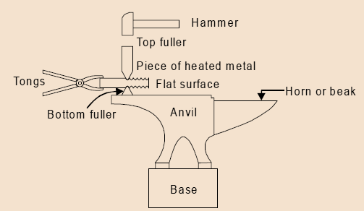
SMITH OR HAND FORGING

Slide 17
TYPES OF SMITH FORGING
FULLERING
FLATTENING
SWAGING
PUNCHING
DRIFTING
BENDING
SETTING DOWN

Slide 18
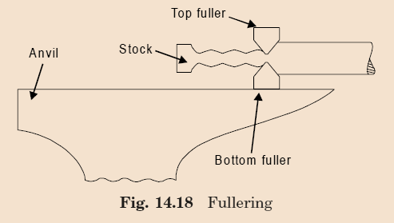
FULLERING

Slide 19
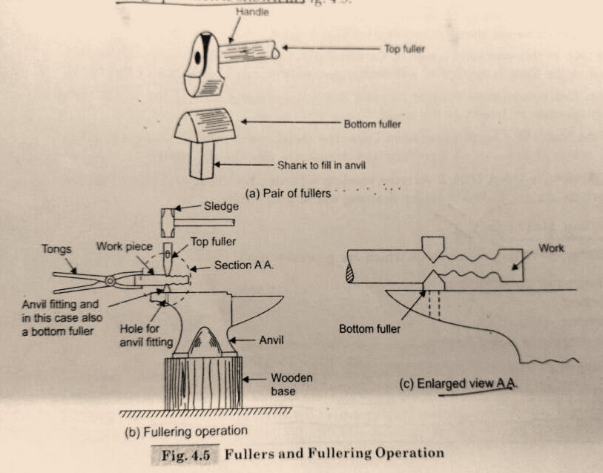
FULLERING

Slide 20
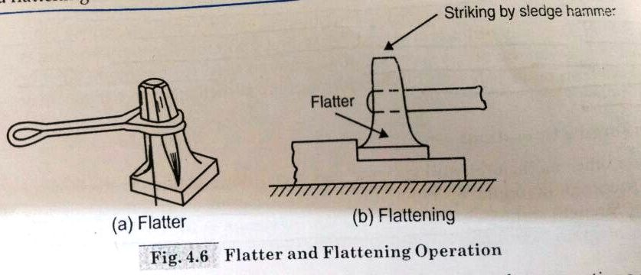
FLATTENING

Slide 21
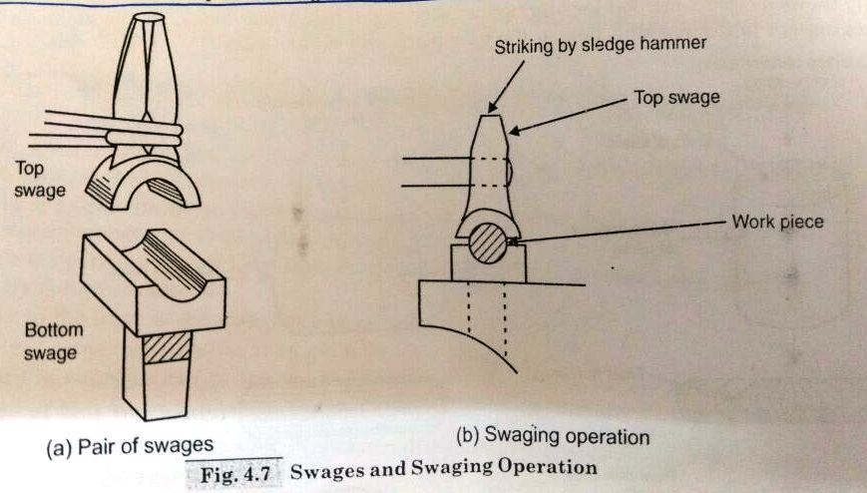
SWAGING

Slide 22
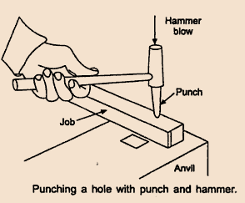
PUNCHING

Slide 23
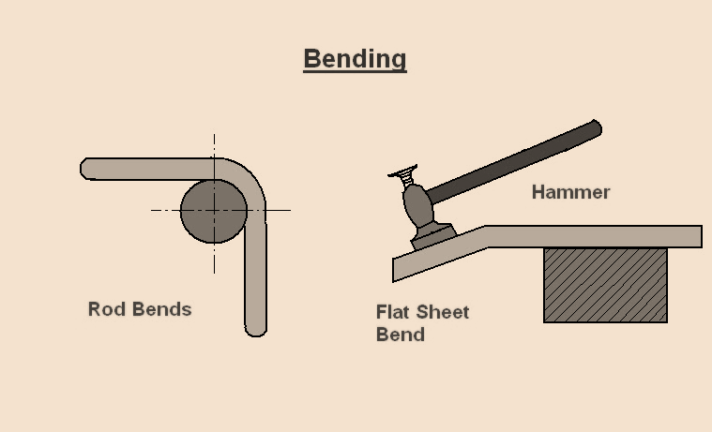
BENDING

Slide 24
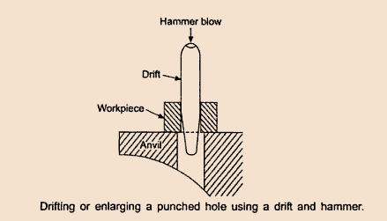
DRIFTING

Slide 25
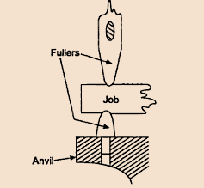
SETTING DOWN

Slide 26
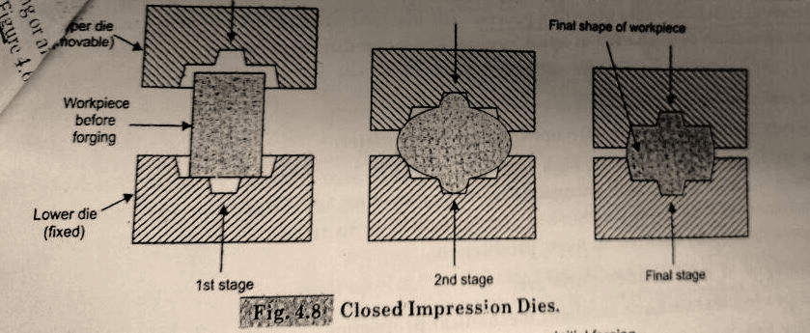
DROP FORGING

Slide 27
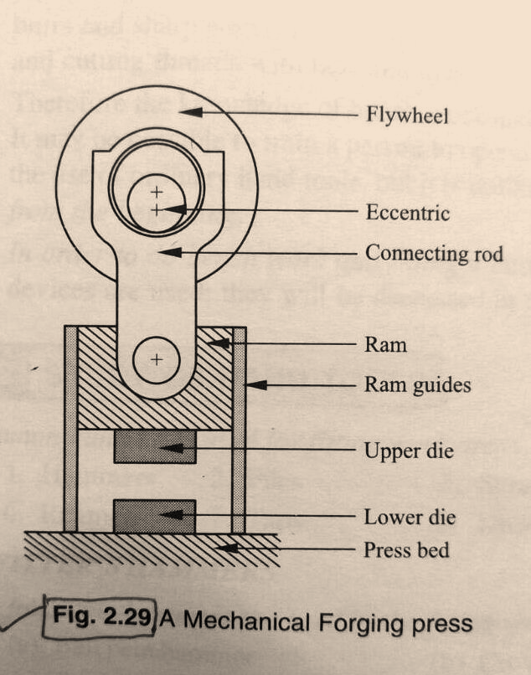
PRESS FORGING

Slide 28
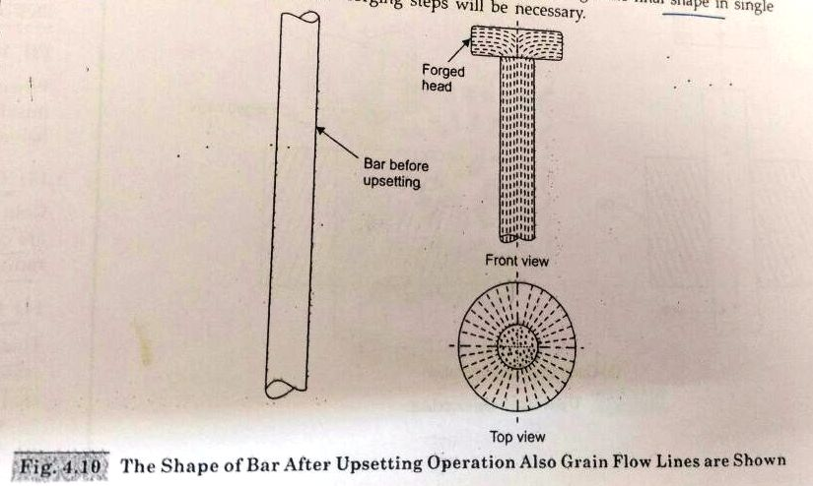
UPSET OR MACHINE FORGING

Slide 29
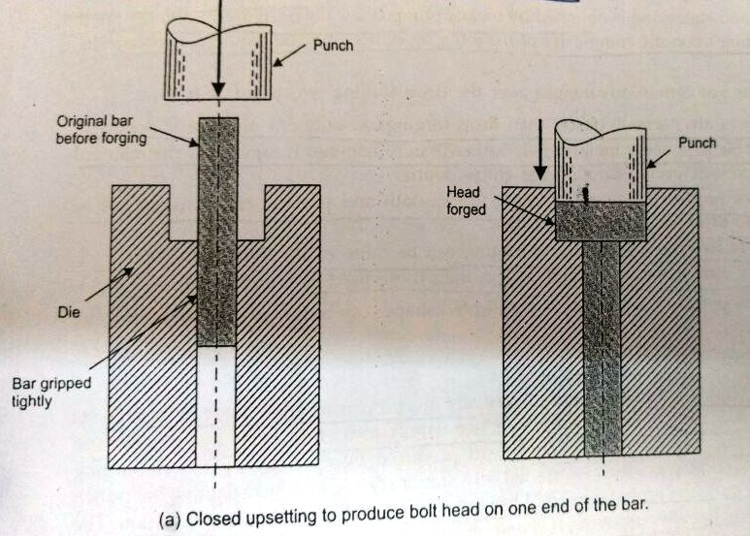
UPSET OR MACHINE FORGING (CLOSE)

Slide 30
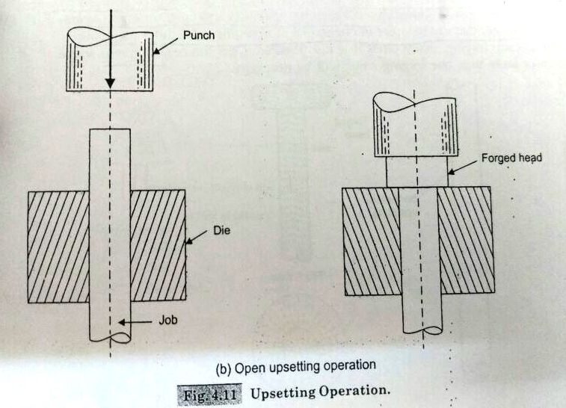
UPSET OR MACHINE FORGING (OPEN)

Slide 31
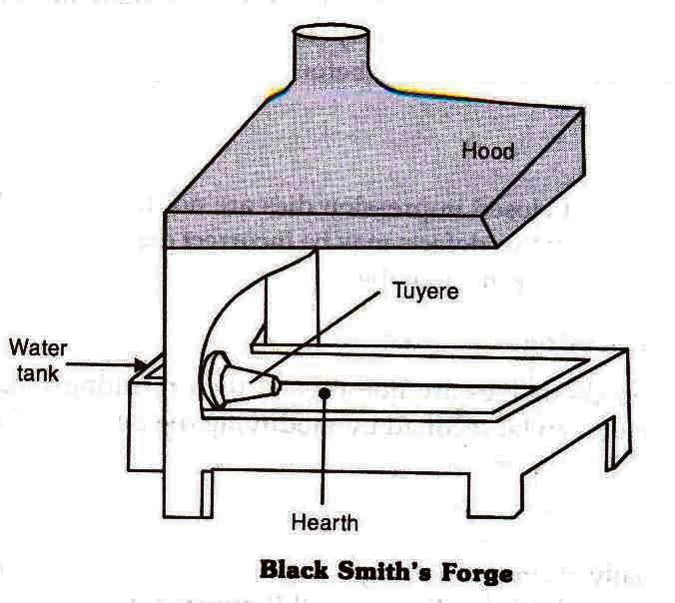
FORGING TOOLS

Slide 32
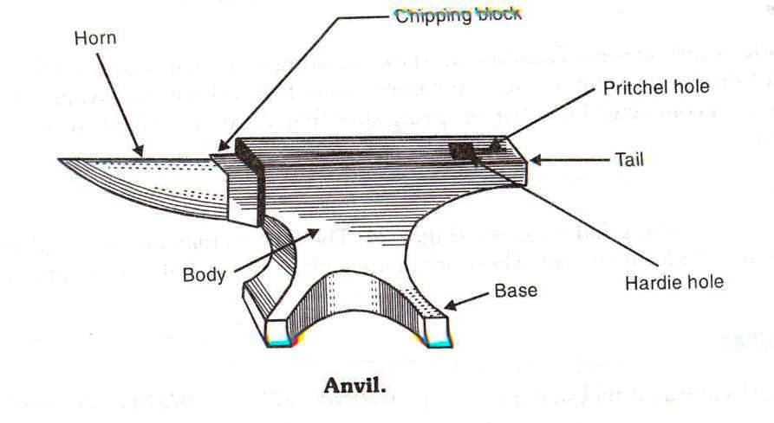
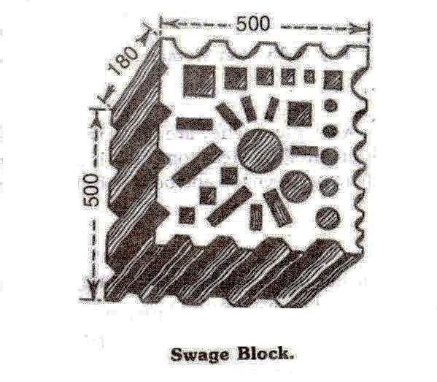
FORGING TOOLS

Slide 33
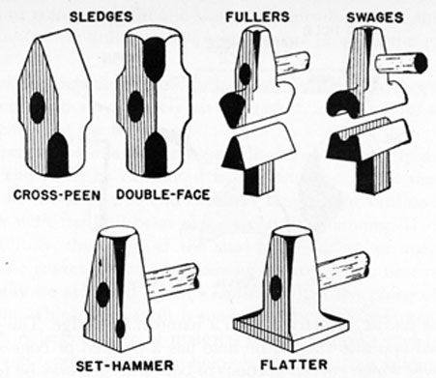
FORGING TOOLS

Slide 34
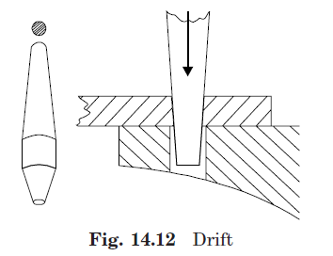
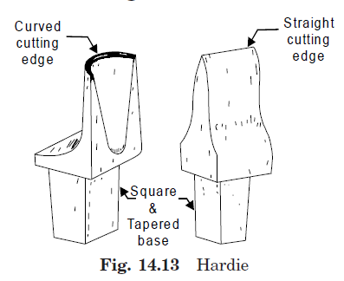
FORGING TOOLS

Slide 35
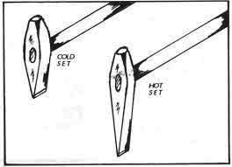
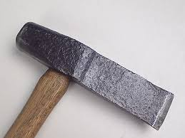
FORGING TOOLS
COLD & HOT CHISEL

Slide 36
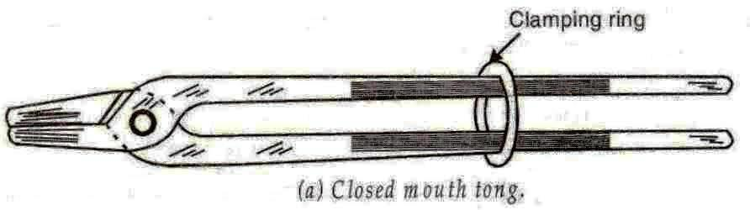
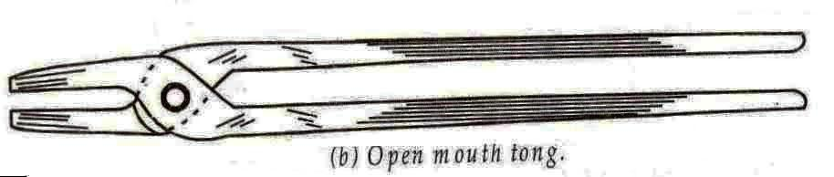
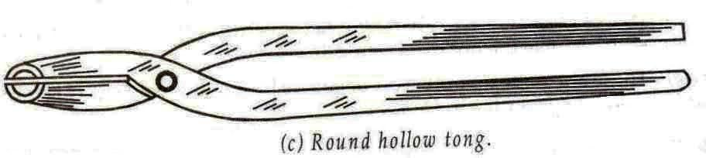
FORGING TOOLS

Slide 37
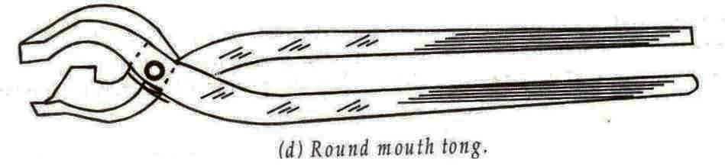
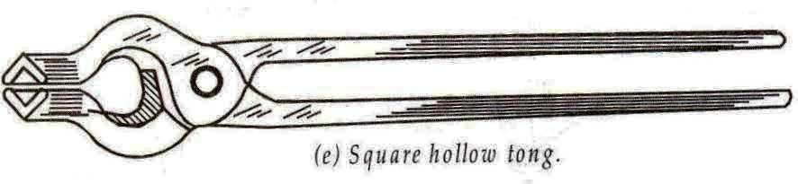
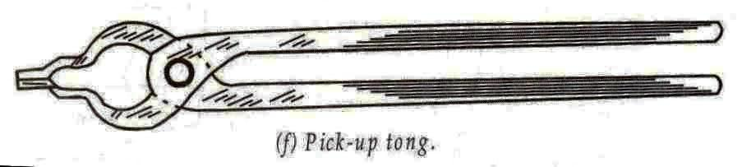
FORGING TOOLS

Slide 38
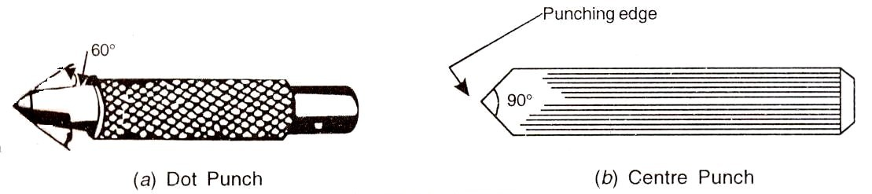
FORGING TOOLS

Slide 39
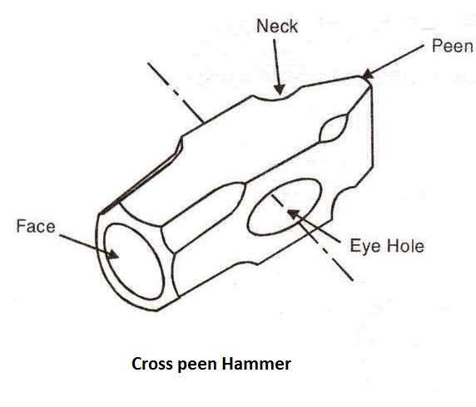
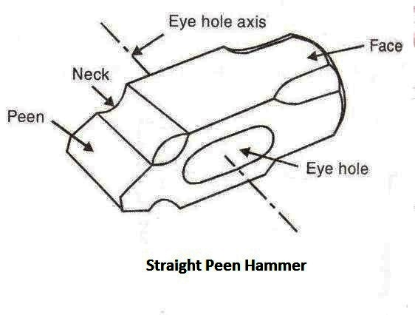
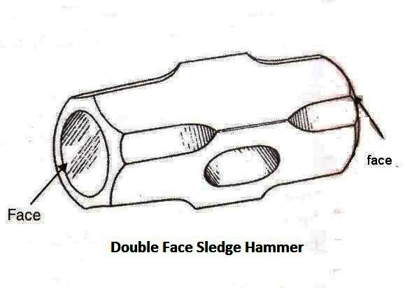
FORGING TOOLS

Slide 40
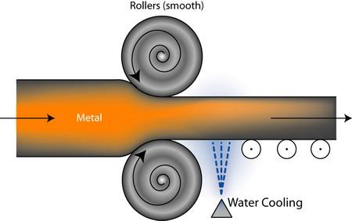
‹#›

Slide 41
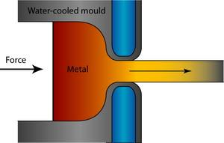
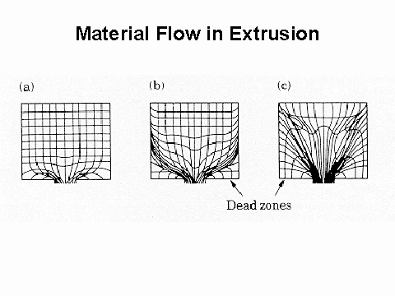
WHAT IS EXTRUSION
A material is pushed or drawn through a die of the desired cross-section .Any solid or hollow cross-section may be produced by extrusion, which can create essentially semi-finished parts. The metal can forcing through a die in the same direction or opposite direction.

Slide 42
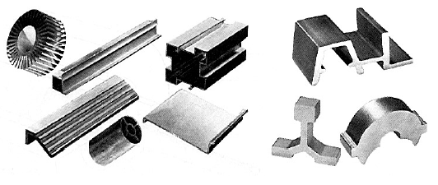
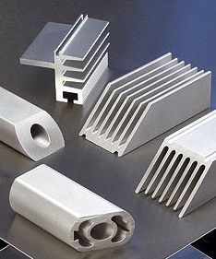
Extrusion
Typical use: ductile metals (Cu, Steel, Al, Mg), Plastics, Rubbers
Common products:
Al frames of white-boards, doors, windows, …

Slide 43
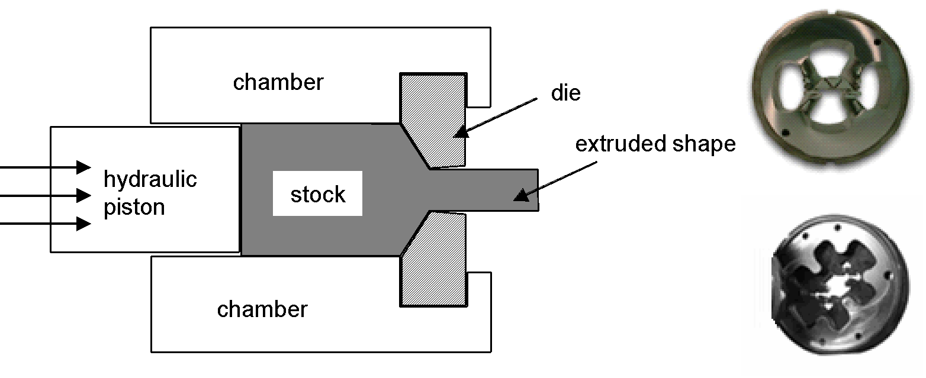
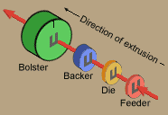
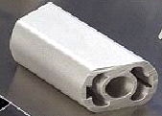
Extrusion: Schematic, Dies
Exercise: how can we get hollow parts?

Slide 44
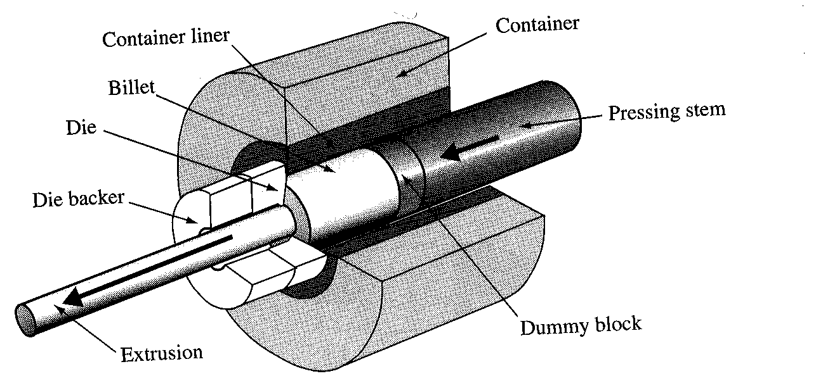
The cross-sections that can be produced vary from solid round, rectangular, to L shapes, T shapes.
Extrusion may be continuous (theoretically producing indefinitely long material) or semi-continuous (producing many pieces). Extrusions can be done with the material hot or cold.
Commonly extruded materials include metals, polymers, ceramics, and foodstuffs.

Slide 45

Direct extrusion: A metal billet is located into a container, and a ram compresses the material, forcing it to flow through one or more openings in a die at the opposite end of the container.
Indirect extrusion: The die is mounted to the ram rather than at the opposite end of the container. One advantage of the indirect extrusion process is that there is no friction, during the process, between the billet and the container liner.

Slide 46
Extrusion: Schematic, Dies
Exercise: how can we get hollow parts?

Slide 47

Drawing
Similar to extrusion, except: pulling force is applied
Commonly used to make wires from round bars

Slide 48

WHAT is DRAWING?
Drawing is an operation in which the cross-section of solid rod, wire or tubing is reduced or changed in shape by pulling it through a die.
The principle of this procedure consist of reducing the thickness of a pointed ,tapered wire by drawing it through a conical opening in a tool made of a hard material.The wire will take shape of the hole.

Slide 49
Drawing improves strength and hardness when these properties are to be developed by cold work and not by subsequent heat treatment
Where is it used?
This process is widely used for the production of thicker walled seamless tubes and cylinders therefore; shafts, spindles, and small pistons and as the raw material for fasteners such as rivets, bolts, screws.

